Slide 1
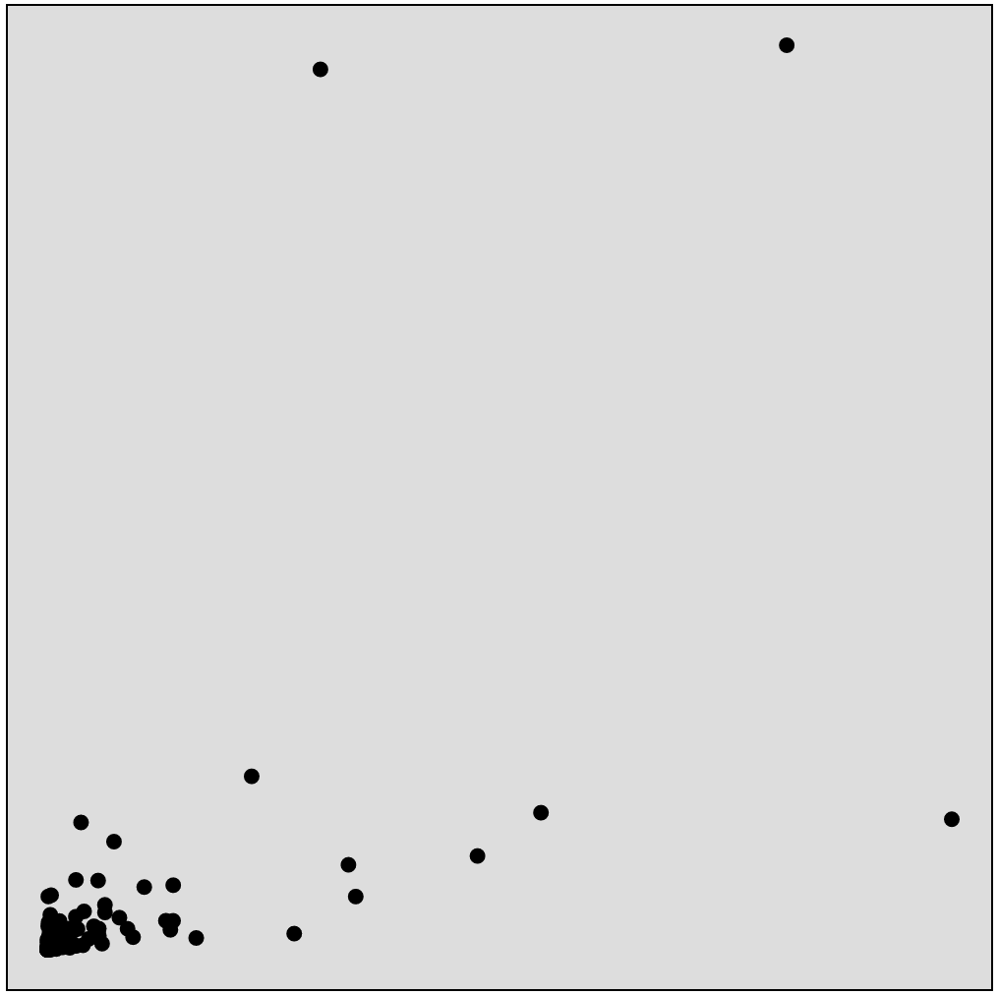
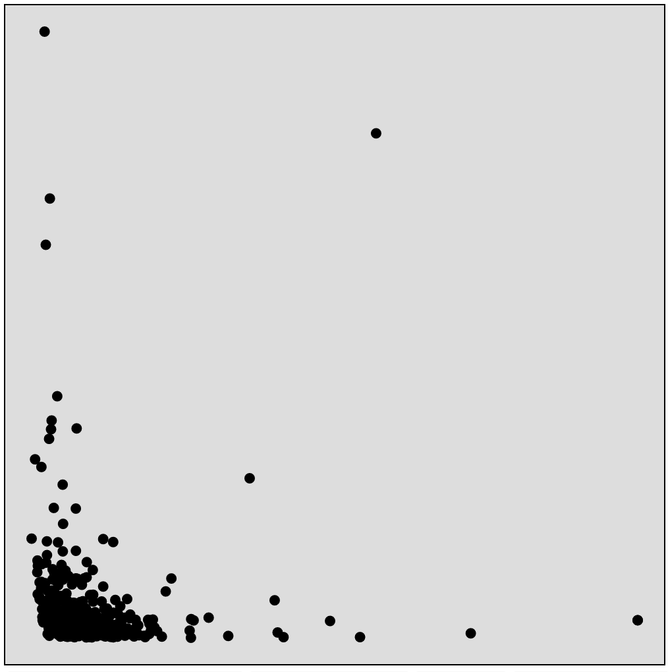
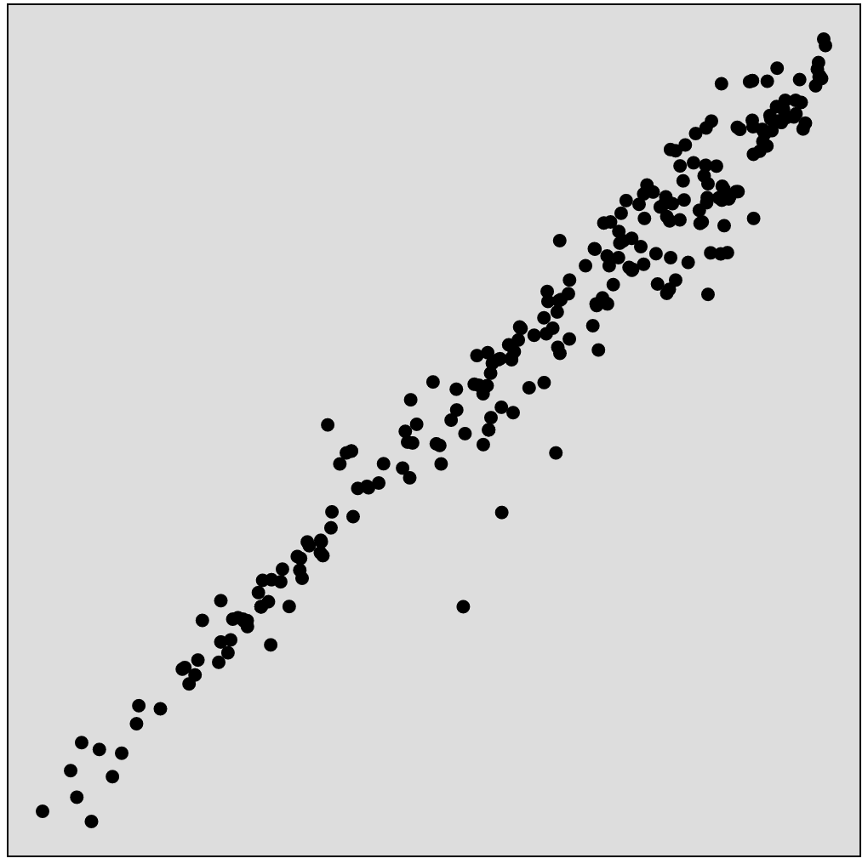



International debt in 2017
NY stock exchange on Jan 2011
Life expectancy in 1982
China
BAC
India
AAPL
Population
Volume
Male
NFLX
Irag
El Salvador
Iran
Pakistan
PCLN
GOOG
Debt
Price
Female
(a)
(b)
(c)
Facts
Pic0:
International debt (india) -> Debt vs. Population (Year 2017)
Pic 1
New York stock exchange price vs. volume (Jan 2011)
BAC: 14.3 vs. 232571115
AAPL: 338.38 vs. 1355
Pic 2
Life expectancy 1982
Life expectancy at birth (years), female vs. male

Slide 2
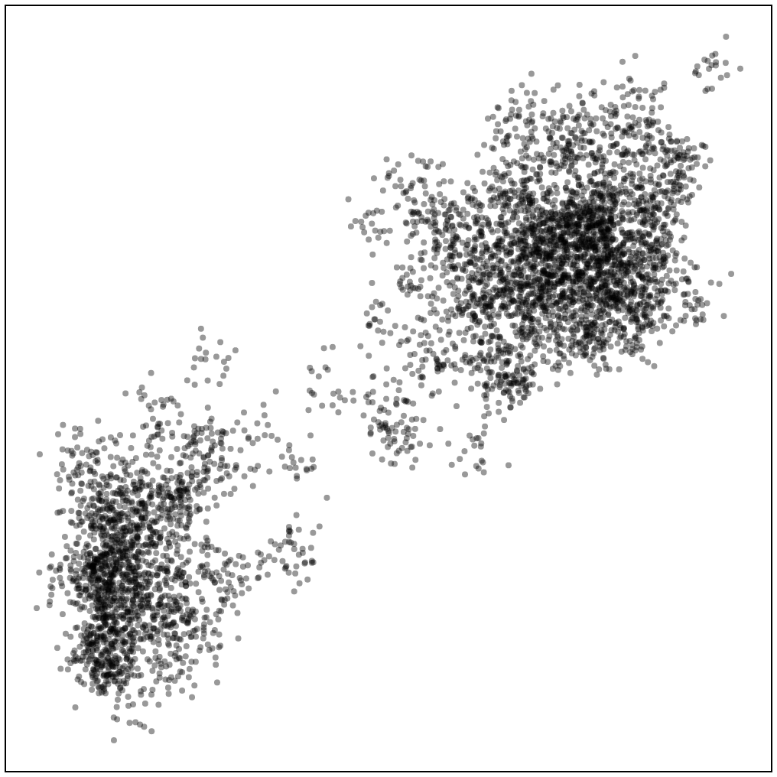
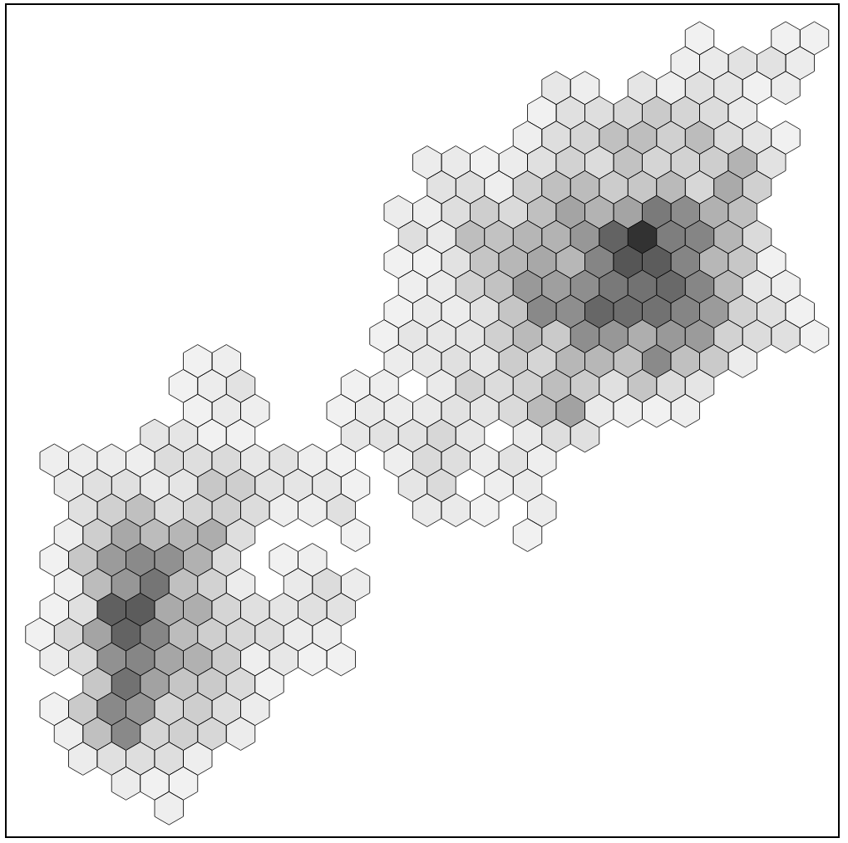
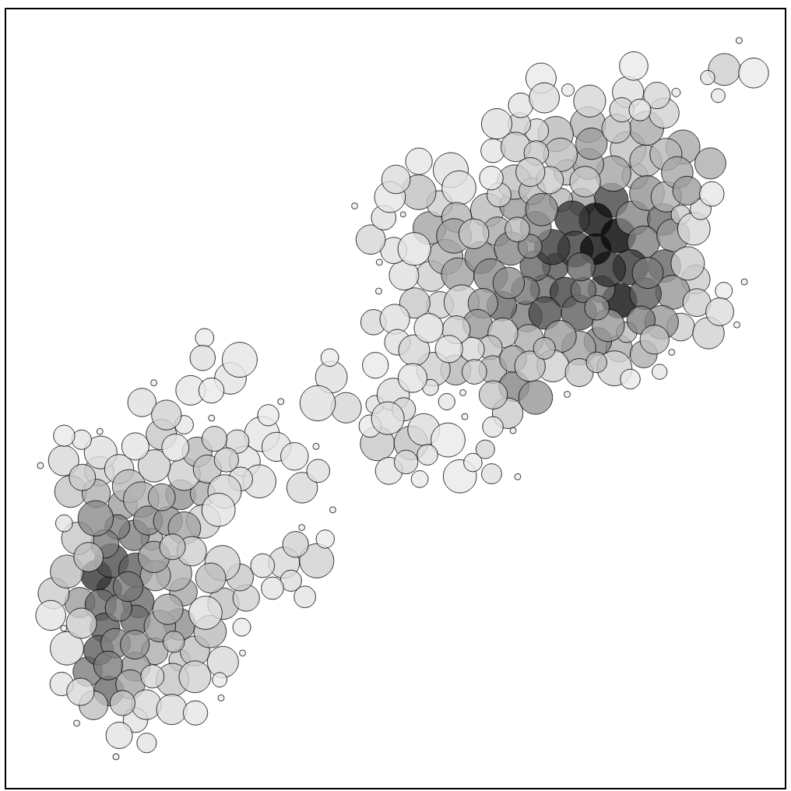
Original data
Hexagon Binning
Leader Binning
Waiting time
Waiting time
Waiting time
Eruption duration
Eruption duration
Eruption duration
(a)
(b)
(c)

Slide 3
Waiting time
Waiting time
Eruption time
Eruption time

Slide 4
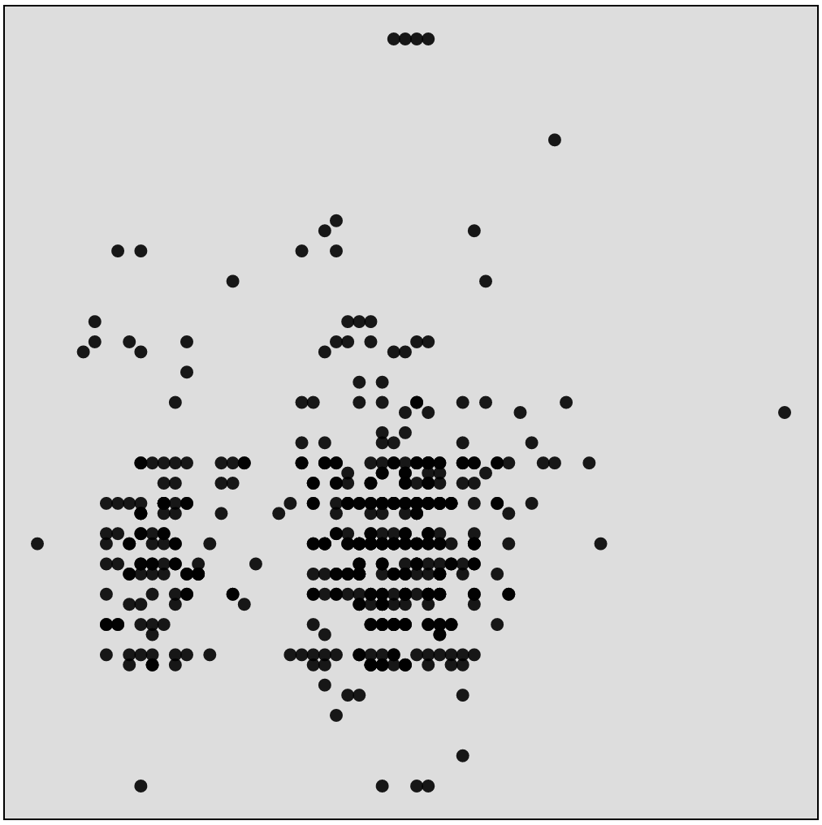
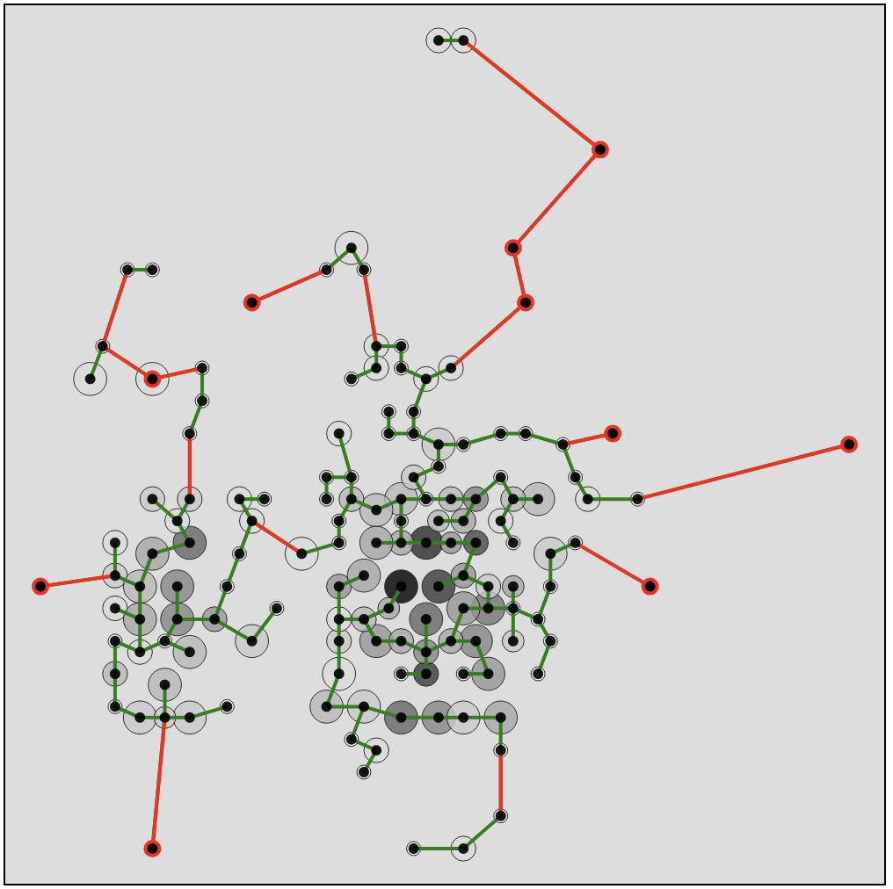
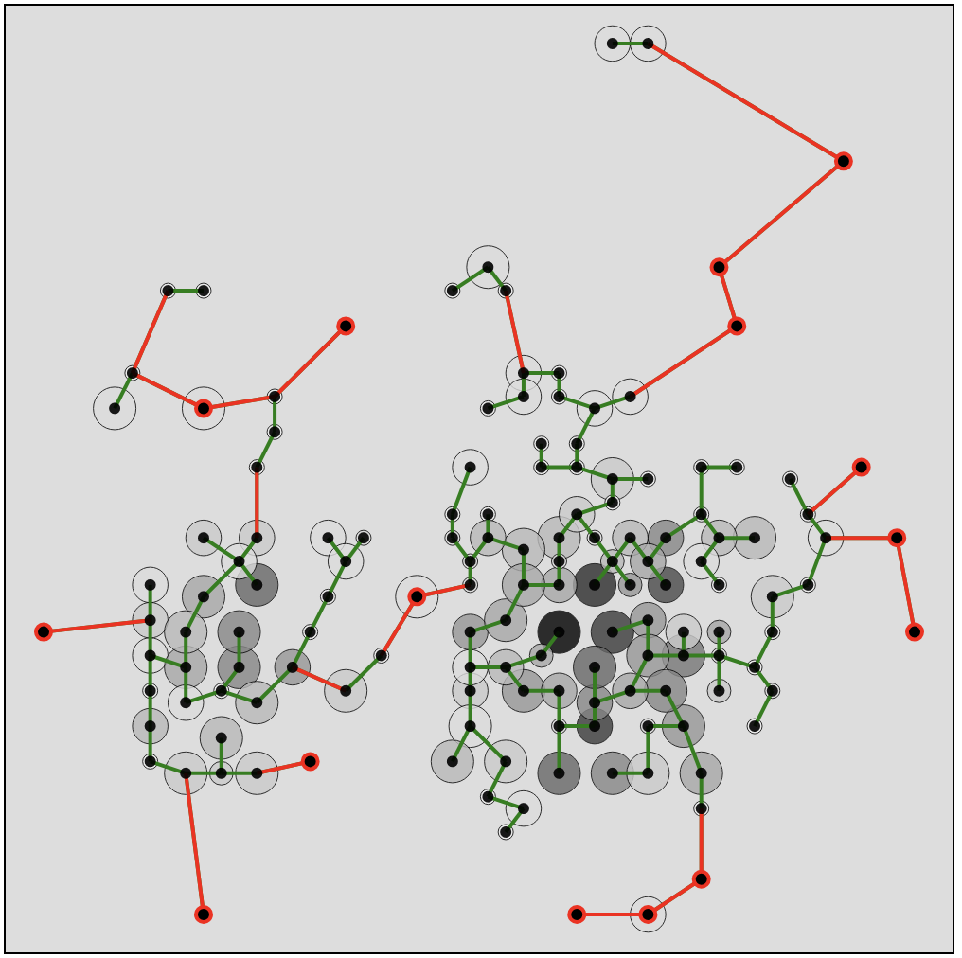
Original data
Hexagon Binning on Original data
Hexagon Binning on leave-1-out
Fan speed
Fan speed
Fan speed
CPU Temperature
CPU Temperature
CPU Temperature
cmpute-9-47

Slide 5
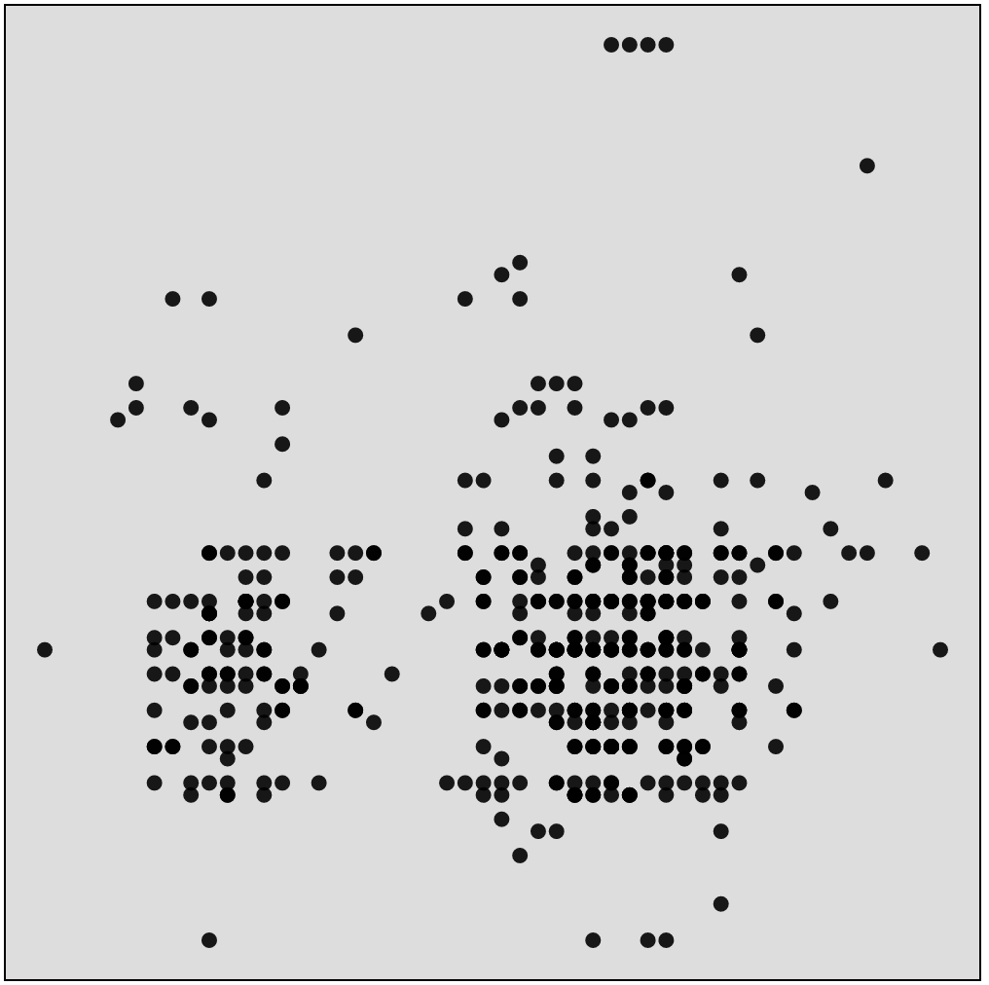
Fan speed
Fan speed
CPU Temperature
CPU Temperature
Fact: Naïve leave-one-out approach may lead to wrong result due to different cut points, so leave outlier may increase outlying score => due to increased number of outlying edges

Slide 6
Time (ms)
(a)
Time (ms)
(b)

Slide 7
Time (ms)
(c)

Slide 8
Time (ms)
(c)
Time (ms)
(d)

Slide 9
Time (ms)
Time (ms)
Time (ms)
Time (ms)
Fact: Fig 1. Processing time is different from one another mostly due to the binning process, and the constraints about the number of bins to be from 50 to 250, e.g., for WTRSM we start with 20x20 bin grid size, in case there are few number of data points and they are too close to one another so we need to add 5 to the bin grid size and re-bin to get enough number of points, in this case, the calculation even get up to 750 x 750 bin grid size (this explain the computation time for binning)
Fig 2, Fig 3: HPCC data set => the points are sparse widely so there are more bins (means more points) to process comparing to others
Fig 4: The total leave-out-out outlier computation time divided by the total number of observations multiply total number of time steps. This show that our approach scale well to big data (due to the assumption of leaving out only the ‘singleton’ bin.

